Slide 1


“Capstone Project – Attendance and Leave Management System ”
Submitted by: Bammidi Vihar, Mayur, Arshad
Submission type : Group 6
Name’s: Bammidi Vihar, Mayur, Arshad
Batch : 12
LMS Id : viharbammidi@gmail.com
Program : Axis Fintech
Date: 13/07/2023
Git Hub Link:
https://github.com/Vihar1179/LAMS_1
Drive Link:
https://drive.google.com/drive/folders/19H9sFQaz3HJv1cSFwC4uU7Ck-15pRXaN?usp=sharing

Slide 2

Table of contents
Introduction
Project Overview
Architecture Design
User Interface Design
ER – Diagram
Front-end Development
Testing
Integration with axios
Conclusion
Future Work
References

Slide 3
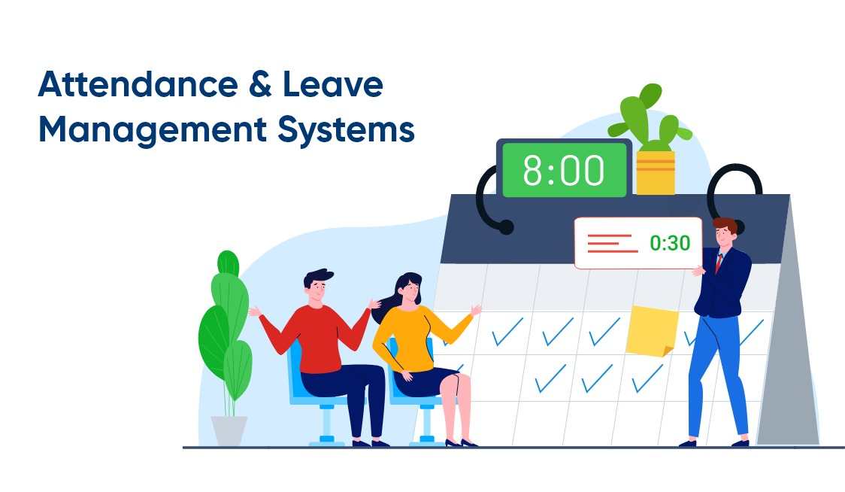
Introduction
What is in it?
Attendance and leave management System is developed in order for the employees to mark their attendance and apply leaves on a regular bases
There are three roles Hr, Employee, Manager
HR is treated as Admin he can add employees and assign managers to the employees
Traditional attendance and leave management systems rely on manual processes, such as paper-based timesheets and leave applications, leading to a significant waste of time and resources. Automating these processes eliminates the need for manual data entry and streamlines the overall workflow.
Without a proper attendance and leave management system, employees may not have clear visibility into their leave balances, accruals, and overall attendance records. This can result in misunderstandings, disputes, and a lack of trust between employees and management.

Slide 4
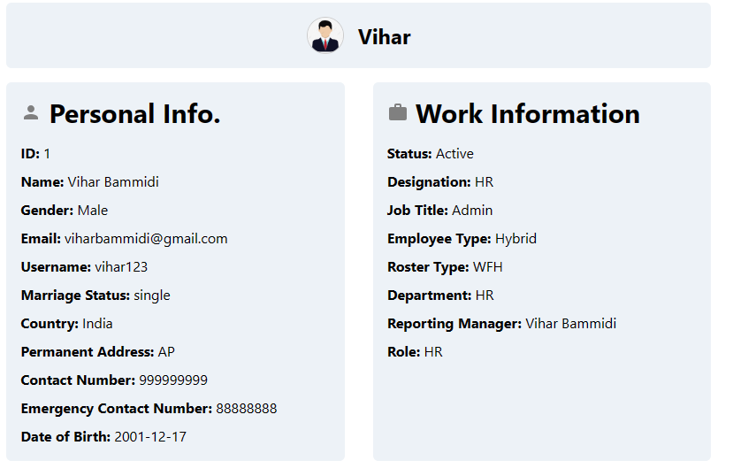

Project Overview
Features:
HR, Manager, Employee – 3 Login types
HR:(Admin)
Add employee through single sheet, Bulk
Can see and edit profile and can see all employee and edit their work information as well as change status and reset leave balance
Can add Departments
Can see the status of Attendance and leave history
can mark attendance for single and multiple days
Will get mail for all the things he need to do
Can apply for leave and check his leave balance
Can add holidays, bulk add holidays can delete holidays and see the calendar
Can see and upload roster in Calendar for all hybrid employees
Can send, upload, delete and open the documents

Slide 5
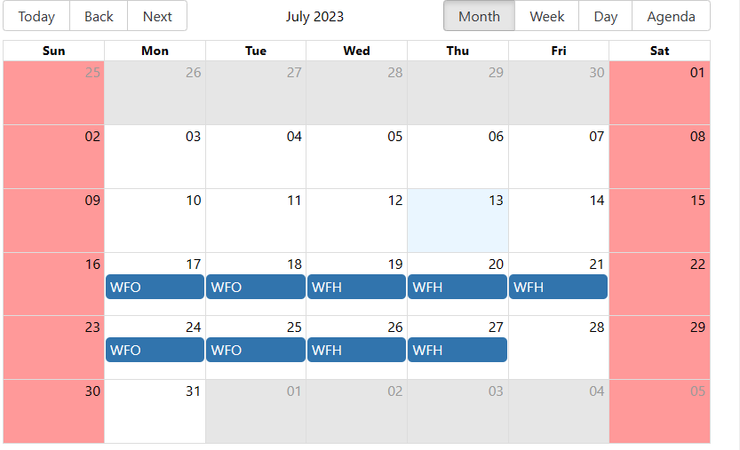
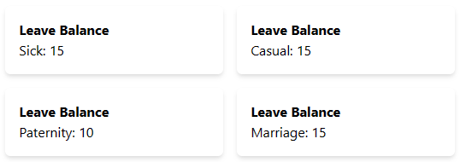
Project Overview
Manager
Can see and edit profile
Can apply for attendance and leave and see their balance leaves
Can approve or reject attendance and leaves
Can see the holidays posted by hr in calendar
Can see their roster if Hybrid employee
Can open and download documents by HR
Employee
Can see and edit profile
Can apply for attendance and leave and see their balance leaves
Can see their leaves and attendance history
Can see their roster if Hybrid employee
Can open and download documents by HR
Can check holidays posted by HR

Slide 6
Technology Used
Front end | Back end | Database
Axios | Java | My SQL
React JS (Java Script) | Spring-boot | MySQL-connector-java
Chakra UI | Maven
Components like Calendars | JWT, Mail-sender,Lombok
 | JPA, Hibernate
 | Bycrypt
React – big – calendar, XlXS – For excel, Date picker for blocking calendar, Chakra UI Icons for Icons
Tools: Visual Studio, Intellij, My sql- command-line, Postman

Slide 7
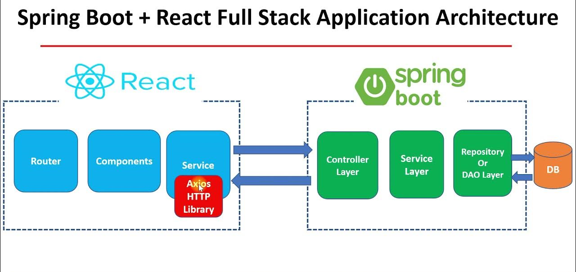
Architecture Design

Slide 8
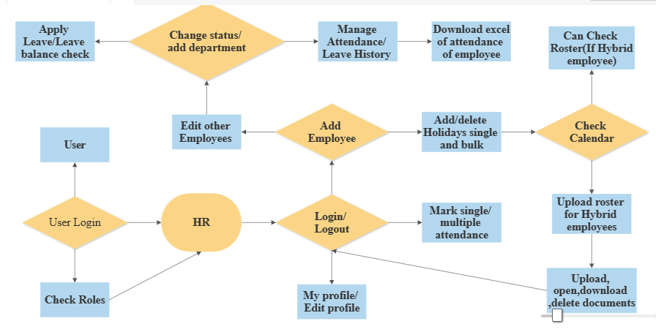
User Interface Design - HR

Slide 9
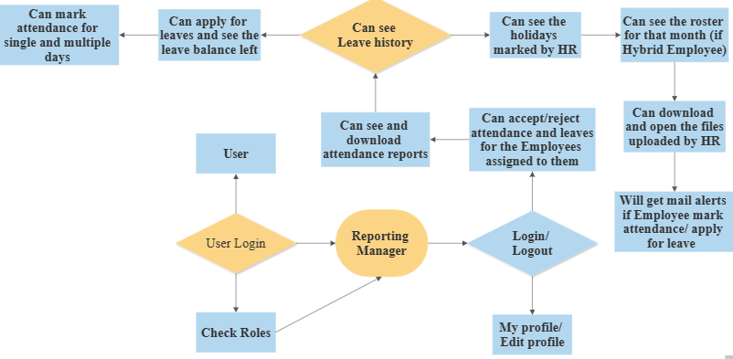
User Interface Design – Manager

Slide 10
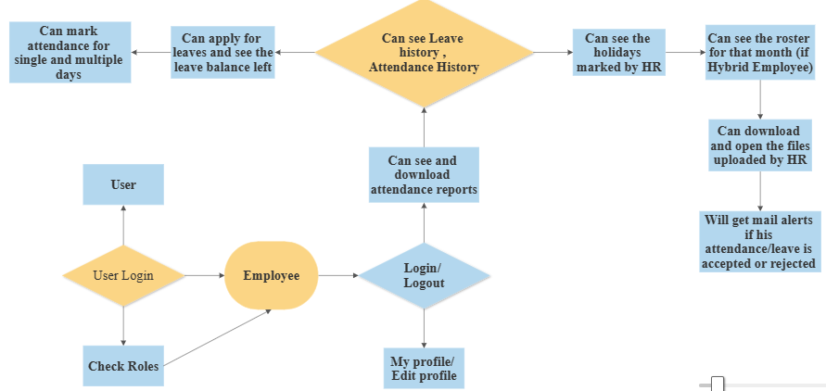
User Interface Design - Employee

Slide 11
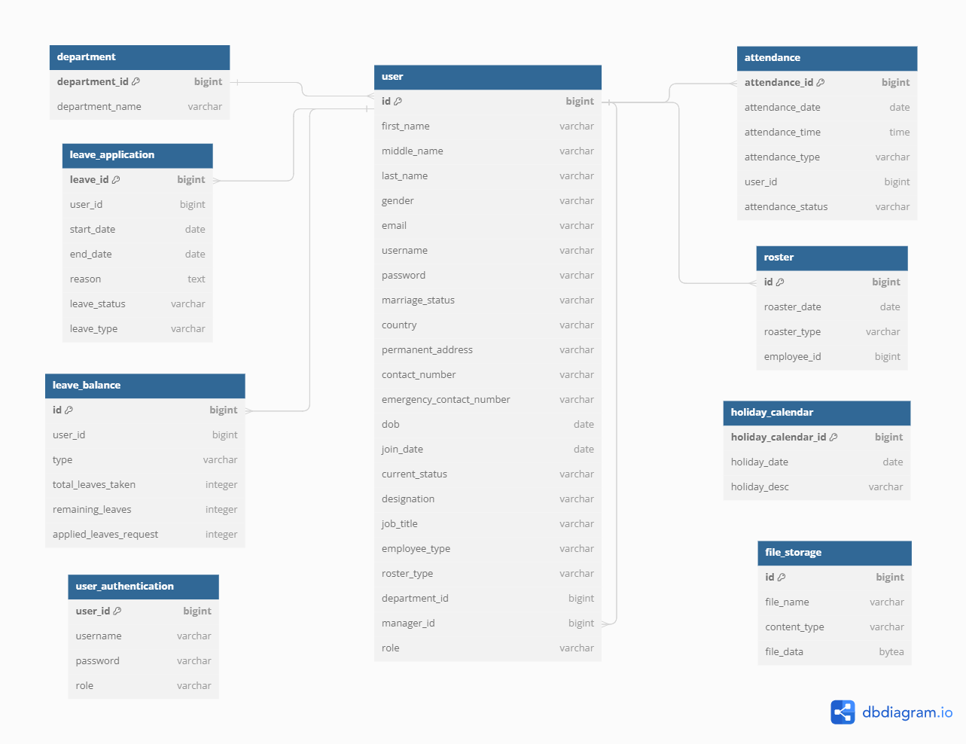
ER – Diagram

Slide 12
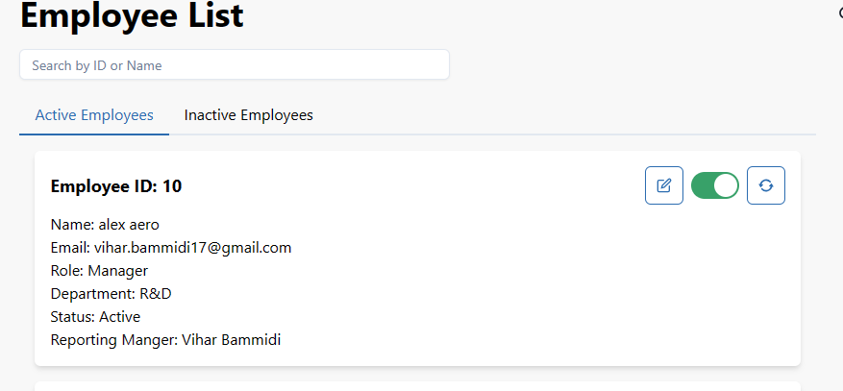
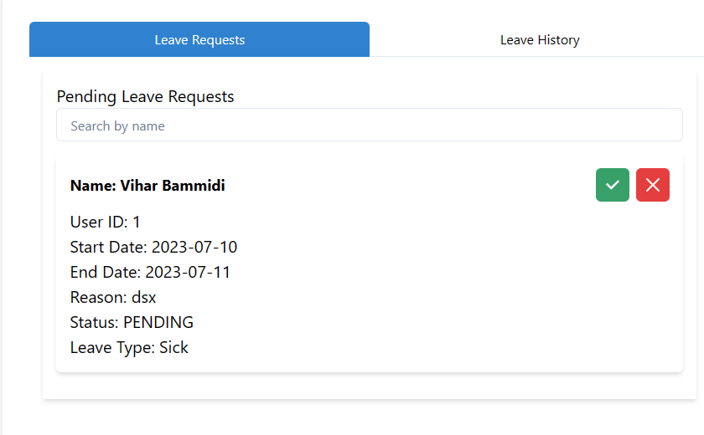
Front-end Development
Languages and Framework used:
Chakra UI To make the UI page Interactive
Java-script and React-JS used react-JS due to virtual Dom
Front-end components
Responsive Frontend With different resolution
Added Search bar for Employee list, Attendance & Leave History to make it User friendly
And for Everything you will be having a dropdown will registering to make it User friendly
We kept Working people and resign people in separate tabs to make the responsive faster when we see the active people
Used axios For connecting end points

Slide 13

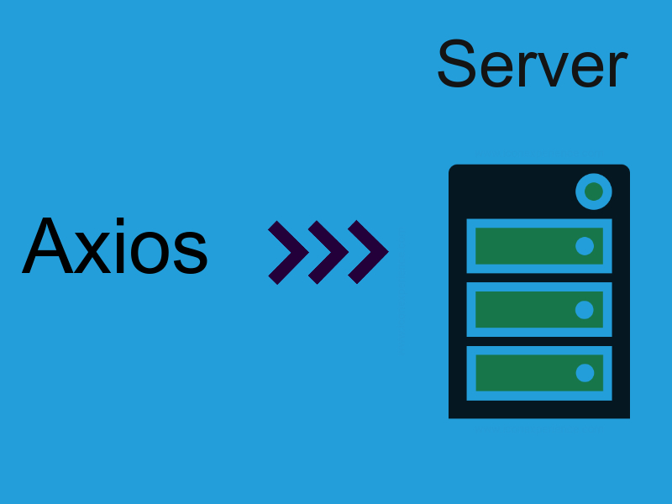
Integration and Testing
Postman:
We used Postman for testing the endpoints before we used to connect it to frontend
Integration
Token and Role retrival: In the getConfig function, the token is retrieved from the sessionStorage using sessionStorage.getItem("token"). Similarly, the role is retrieved from sessionStorage using sessionStorage.getItem("role"). These values are then used to construct the authorization header for subsequent API requests
Login Functionality: In the submitHandler function, the login function is called with the usernameOrEmail and password as parameters. This function is responsible for making an HTTP request to the login endpoint of the backend API using Axios. If the login is successful, the returned accessToken and role are stored in sessionStorage using sessionStorage.setItem.
API Request: In the register function, Axios is used to make an HTTP POST request to the /user/register endpoint of the backend API. The userData is sent as the request payload, and the getConfig function is used to include the authorization header with the request. The response is then returned.

Slide 14
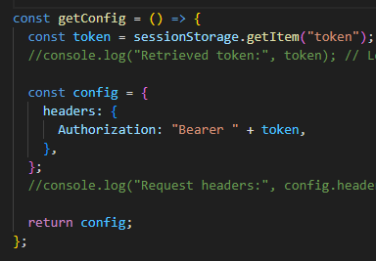
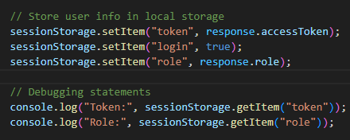
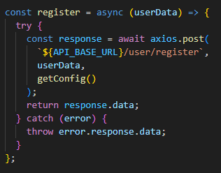
Integration and Testing
Integration:
Session Storage Usage: After a successful login, the accessToken and role are stored in sessionStorage using sessionStorage.setItem. These values are later retrieved using sessionStorage.getItem when making subsequent API requests. This allows the frontend to send the authorization token along with the requests to the backend API.
Storing in session storage
Register Function
Get config

Slide 15


Conclusion
Conclusion:
The implementation of an Attendance and Leave Management System is crucial for modern organizations to streamline their workforce management processes and optimize operational efficiency. By leveraging advanced technology, such a system allows for accurate tracking of employee attendance, simplifies leave requests and approvals, and enhances overall productivity.
Through the course of this presentation, we have explored the key features and benefits of an Attendance and Leave Management System. We have seen how it automates timekeeping, eliminates manual errors, provides real-time insights into attendance patterns, and simplifies the leave management process. These advantages not only save time and effort for HR personnel but also empower employees to manage their attendance and leave effectively.

Slide 16

Future Work
Future Scope:
Integration with Time and Attendance Devices: Explore the possibility of integrating the portal with advanced time and attendance devices such as facial recognition systems or fingerprint scanners to provide more secure and accurate attendance tracking.
Automated Workflow Management: Implement an automated workflow system for leave requests and approvals, streamlining the process and reducing administrative overhead.
Employee Performance Tracking: Integrate performance management features into the portal, allowing managers to track employee performance metrics alongside attendance records for a holistic view of employee productivity.
Integration with Collaboration Tools: Explore integration with collaboration tools such as project management software, instant messaging platforms, or video conferencing tools to create a seamless work environment and enhance team collaboration.

Slide 17



References
ReactJS – References
React documentation : https://reactjs.org/docs
React Tutorial : https://reactjs.org/tutorial/tutorial.html
React Router: https://reactrouter.com/web/guides/quick-start
React Hooks: https://reactjs.org/docs/hooks-intro.html
Spring-boot – References
Spring Boot Documentation: https://docs.spring.io/spring-boot/docs/current/reference/html/
Spring Boot Tutorials by Baeldung: https://www.baeldung.com/spring-boot
My SQL – References
MySQL Documentation: https://dev.mysql.com/doc/
MySQL Tutorial by Guru99:https://www.guru99.com/mysql-tutorial.html

Slide 18

Thank you

